Slide 1
Sprint 1
PerlSquad

Slide 2
Sprint 1 Goals
Be able to tweak minigame difficulty
Implement Biome Selection
Expand Options Menu
Replace scavenger hunt with hover-over info screen
Have in-game images preloaded upon start

Slide 3
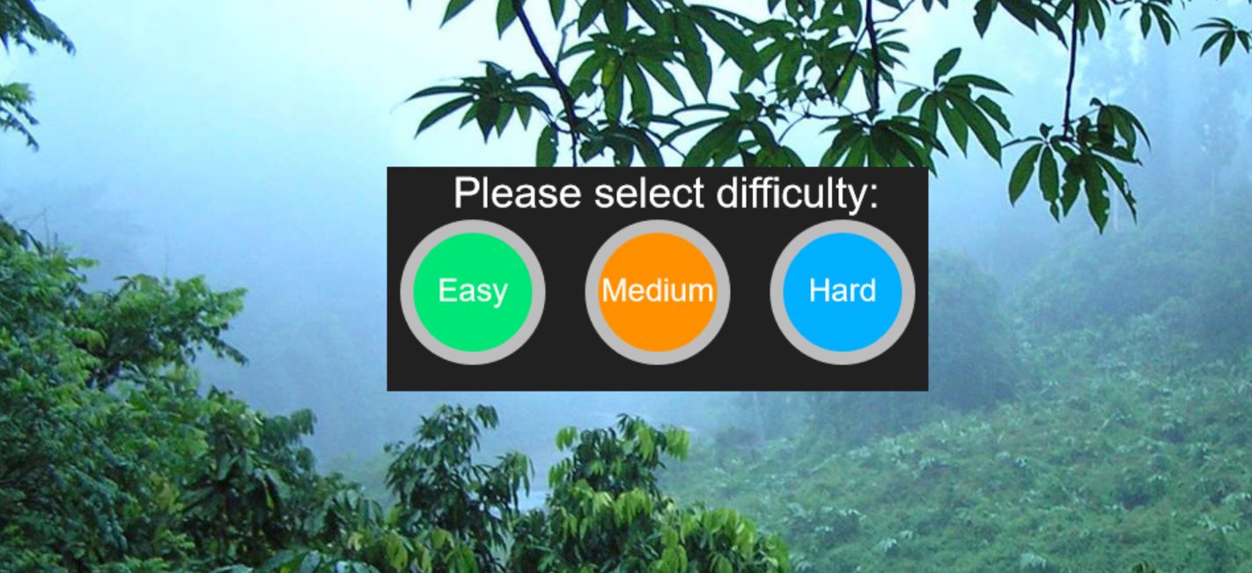
Difficulty Selection:

Slide 4
Successes & Roadblocks:
Difficulty can be adjusted before the minigame starts - currently it just modifies speed of the objects
Implementing buttons not too difficult, only issue is balancing the three settings - what is considered “hard” or “easy” to each user?
Created issue where moving object would load while menu screen, had to play with containers to fix

Slide 5
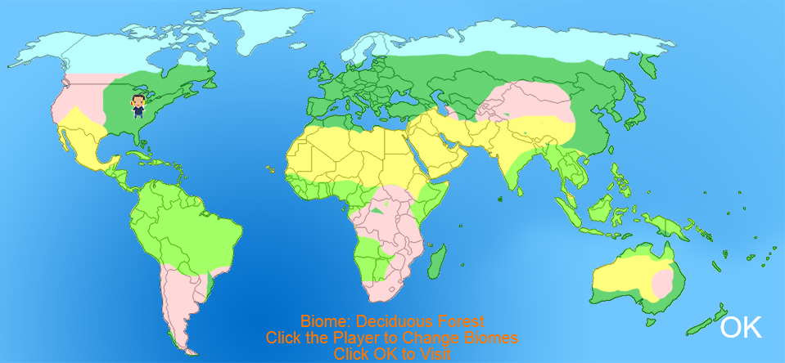
Biome Selection

Slide 6
Successes & Roadblocks:
Implemented a doubly linked cycle for biome traversal - makes tracking unvisited biomes, their names, and their coordinates easy.
Switched out double-clicking for an okay button to allow non-linear game progression.
Gave biomes realistic coordinates - had to tinker with coordinates until they looked right.

Slide 7
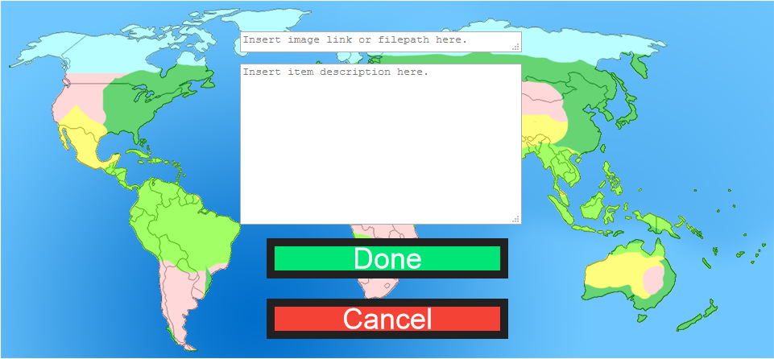
Expanded Options Menu

Slide 8
Successes & Roadblocks:
Added category selector to make adding and editing more efficient.
Added text areas for add option to provide a file path or URL and text description.
Set up Done and Cancel Buttons to confirm or cancel adding objects.
Major roadblock: Permanently adding to manifest has proven difficult - will most likely need to implement backend server to store image paths or URLs and text descriptions.

Slide 9
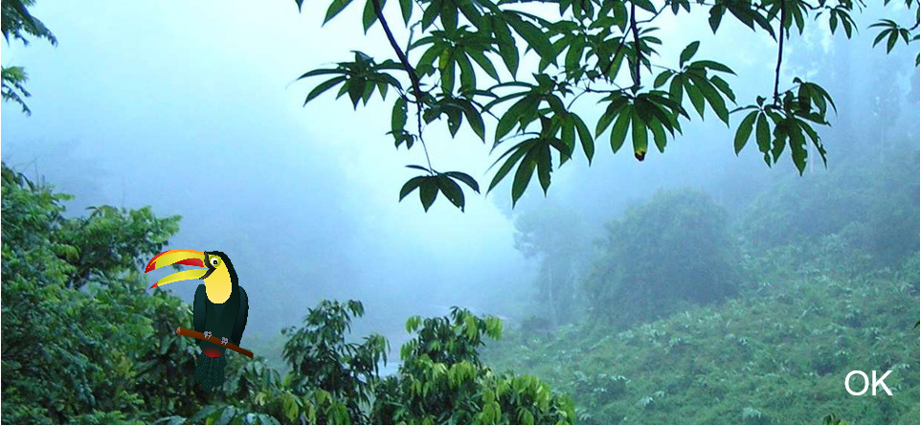
Hover-Over Info Screen

Slide 10
Successes & Roadblocks:
Replaced scavenger hunt page with Info screen - client felt it would encourage students to think for themselves and would draw more attention to biome objects.
Added hover-over events to display and hide text.

Slide 11
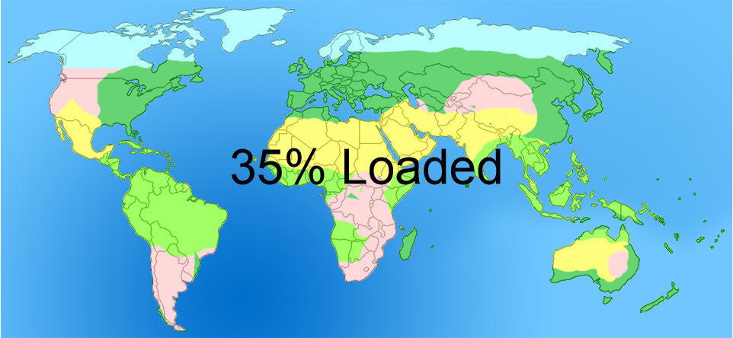
Preload Upon Start

Slide 12
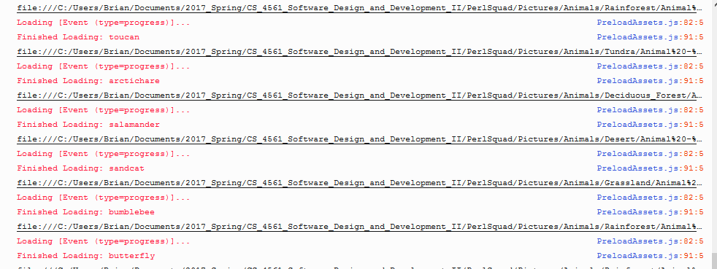
Preload Upon Start (Cont.)

Slide 13
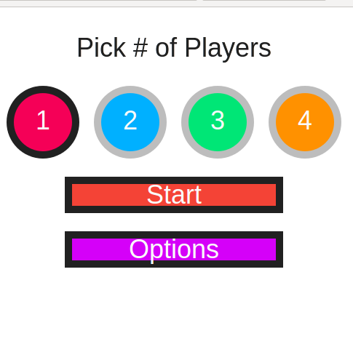
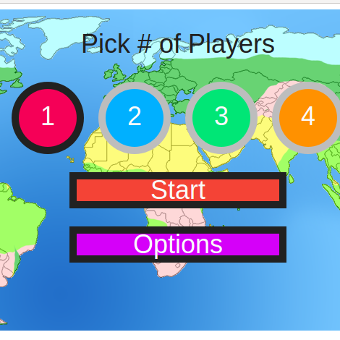
Individual Loading vs. Preload

Slide 14
Successes & Roadblocks:
Filled manifest with all current relevant image file paths
Implemented preloading with progress display included - had to turn off XHR loading and switch to tag loading in order to handle loading local files
Minor Roadblock: Image loaded via URL have to be from CORS-enabled websites - won’t be an issue in most cases - just need to specify to users supported websites

Slide 15
Next
Work with rebalancing difficulty speeds
Associate biomes with their images
Add backend for customization
Fill out hover-over info screen with more objects
Expand the game manifest to include more images and preload those images as well

